Slide 1
Part V Conclusions & Recent Developments
Fausto Carcassi

Slide 2
Intro & structure
Last session!
Part I | Introduction: On the very idea of an LoT
Part II | Technical background
Part III | Bayesian program induction (LOTlib3)
Part IV | Case studies
Part V | Summary & Future prospects

Slide 3
Summary so far
a

Slide 4
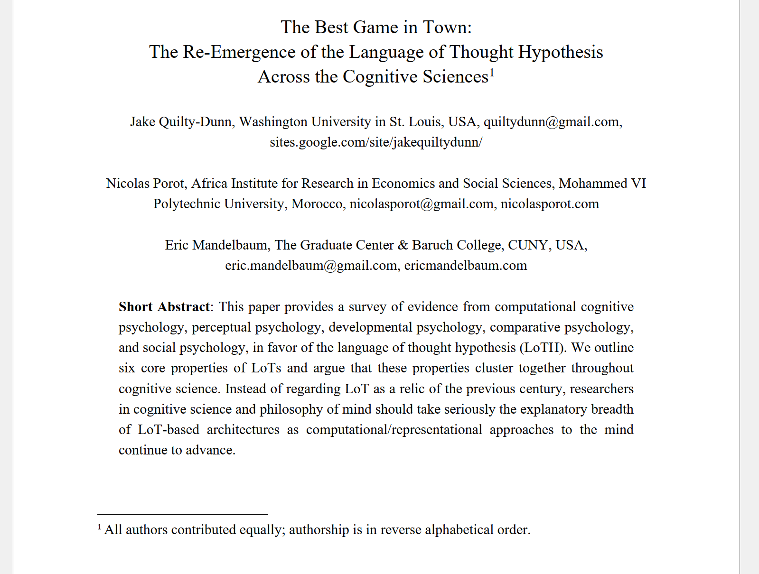
Re-emergence in philosophy
Bla

Slide 5
DreamCoder

Slide 6
Some problems with LOTlib3-style pLoT
Problem I: pLoT is not scalable compared to neural network systems!
Why do you think that is?
Problem II: pLoT needs to start with a domain specific language.
If we start with domain general primitives, programs would be too long!
Problem III: Combinatorial /discrete nature of the search space
The space of programs isn’t continuous, so we can’t use our best algorithms (e.g., gradient descent or Hamiltonian Monte Carlo)

Slide 7
DreamCoder: The general idea
Grow new concepts
Inferred programs become shorter!
Domain adaptability
Learn implicit procedural knowledge
We search the space based on observed object
We need intuition
Train a neural networks to propose programs from observations!

Slide 8
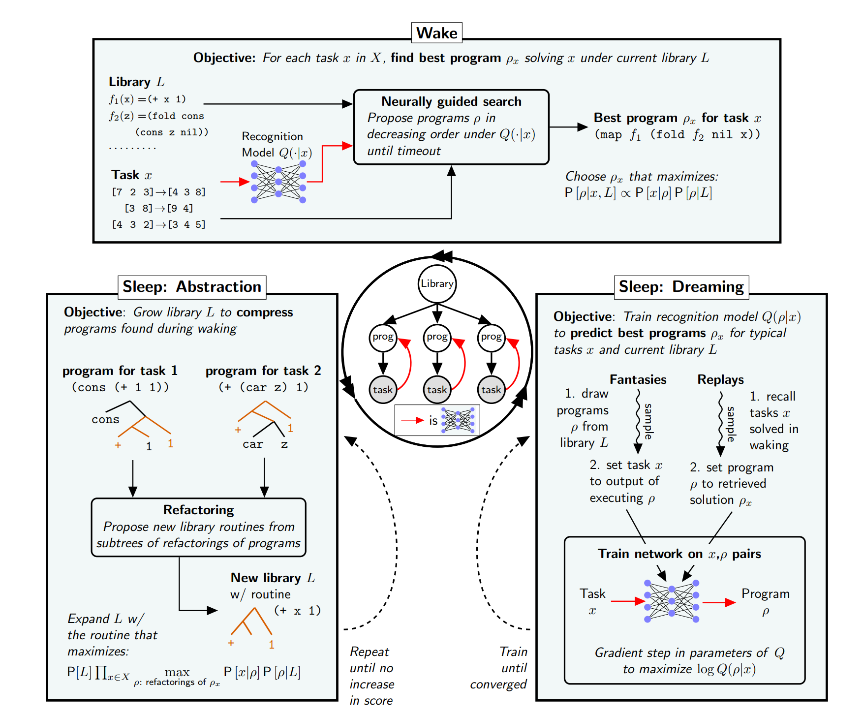
DreamCoder: Learning
How do we grow new concepts?
How and when is the ANN trained?
Solution: Wake/Sleep Program Learning

Slide 9
DreamCoder: Learning

Slide 10
DreamCoder: Learning

Slide 11
DreamCoder
Challenge:
Solving list processing and text editing tasks? (218 problems)
Starting with general-purpose functions
Each round of abstraction builds on concepts from previous sleep cycles
E.g., first learns filter, then uses it to learn to take the maximum element of a list, then uses that routine to learn a new library routine for extracting the nth largest element of a list, which it finally uses to sort lists of numbers

Slide 12
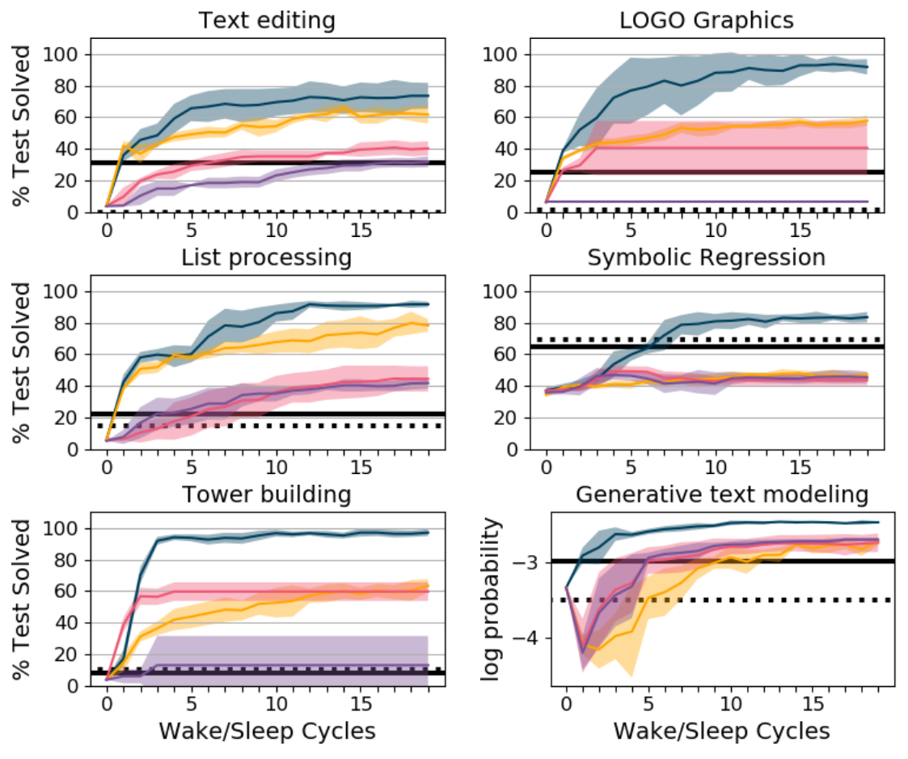
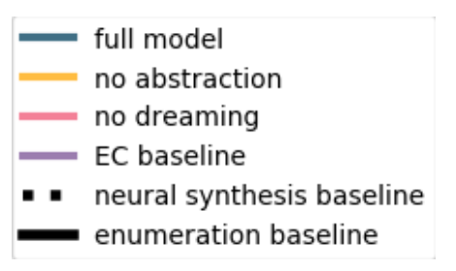
DreamCoder
DreamCoder solves 84.3% of the problems with 1 hour & 8 CPUs per problem.
Strongest baseline (CVC4) solved 82.4% of the problems
CVC4 had a different hand-engineered library of primitives for each problem!

Slide 13
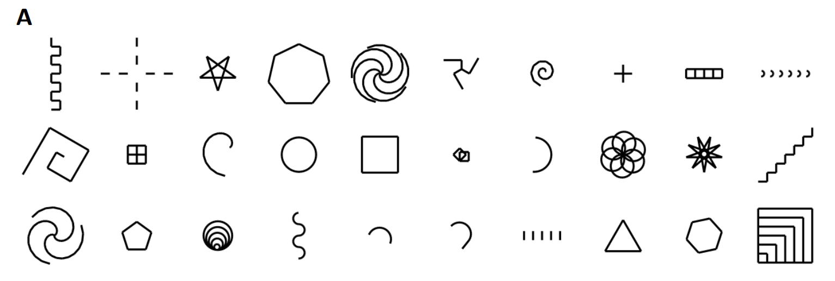
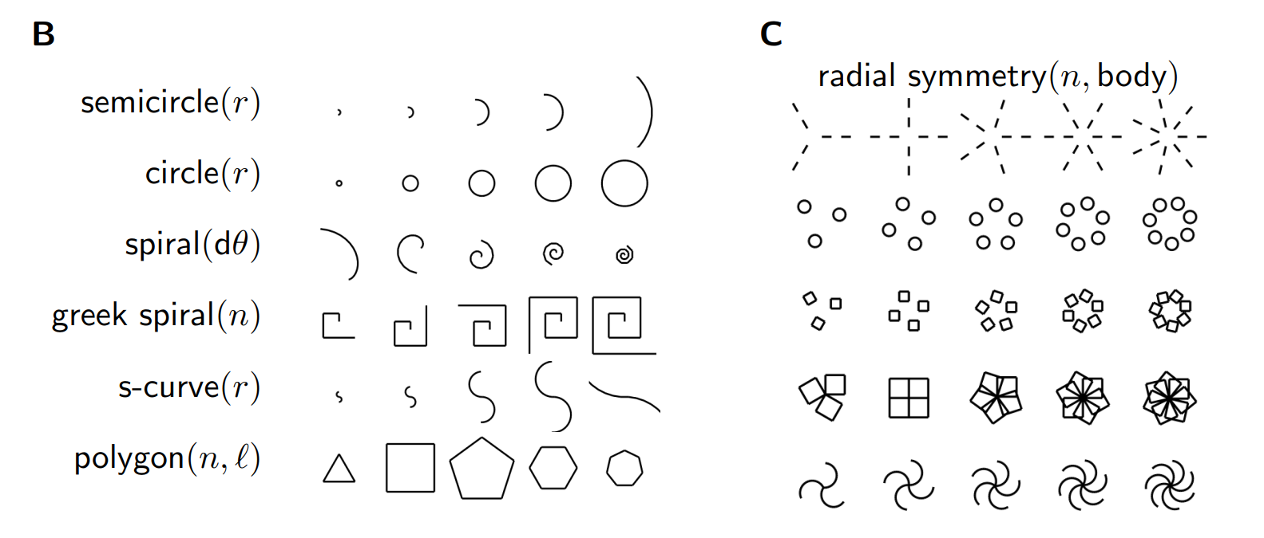
DreamCoder
More creative domains: generating images, plans, and text.
LOGO programs to learn
(30 out of 160)
Some learned
parametric
‘shape concepts’
Some learned
higher-order
functions

Slide 14
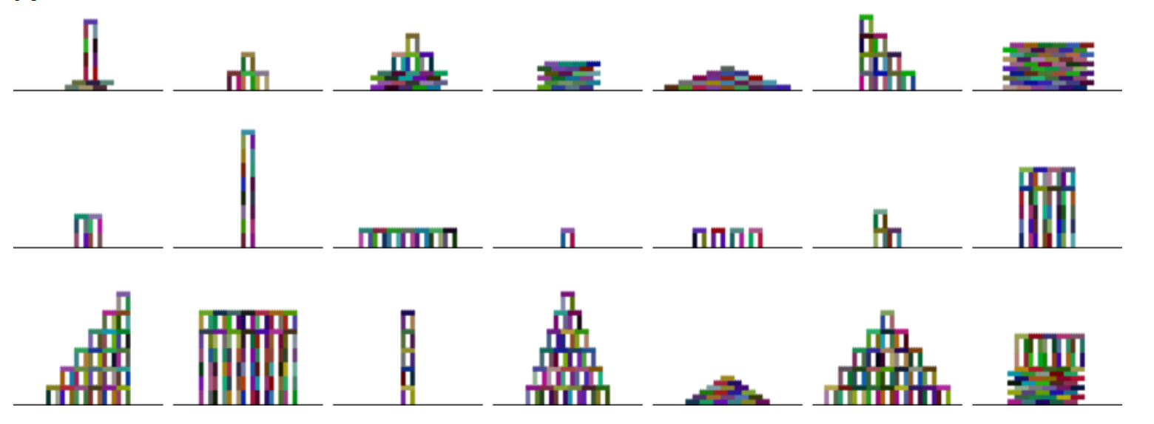
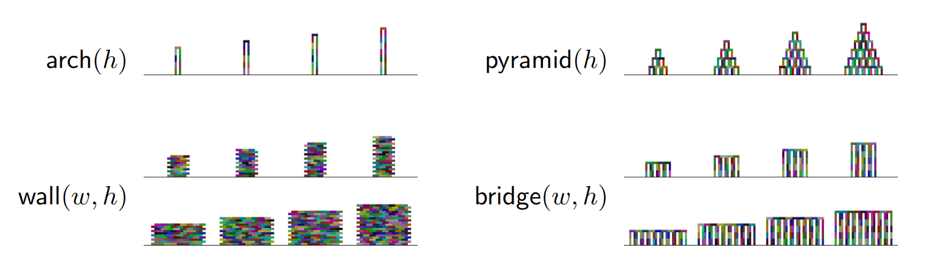
DreamCoder
Towers building
programs to learn
Some learned
parametric
‘shape concepts’
Some learned
higher-order
functions

Slide 15
DreamCoder
New task:
Learn a set of 60 physical laws and mathematical identities from quantitative measurements
E.g., mechanics, electromagnetism
After 8 cycles of wake/sleep, DreamCoder learns 93% of the rules
First learn concepts like inner product or vector sum
Then learn complex like the inverse square law
Finally use these to formulate laws like Newton’s laws of gravitation and Coulomb’s law of electrostatic force

Slide 16
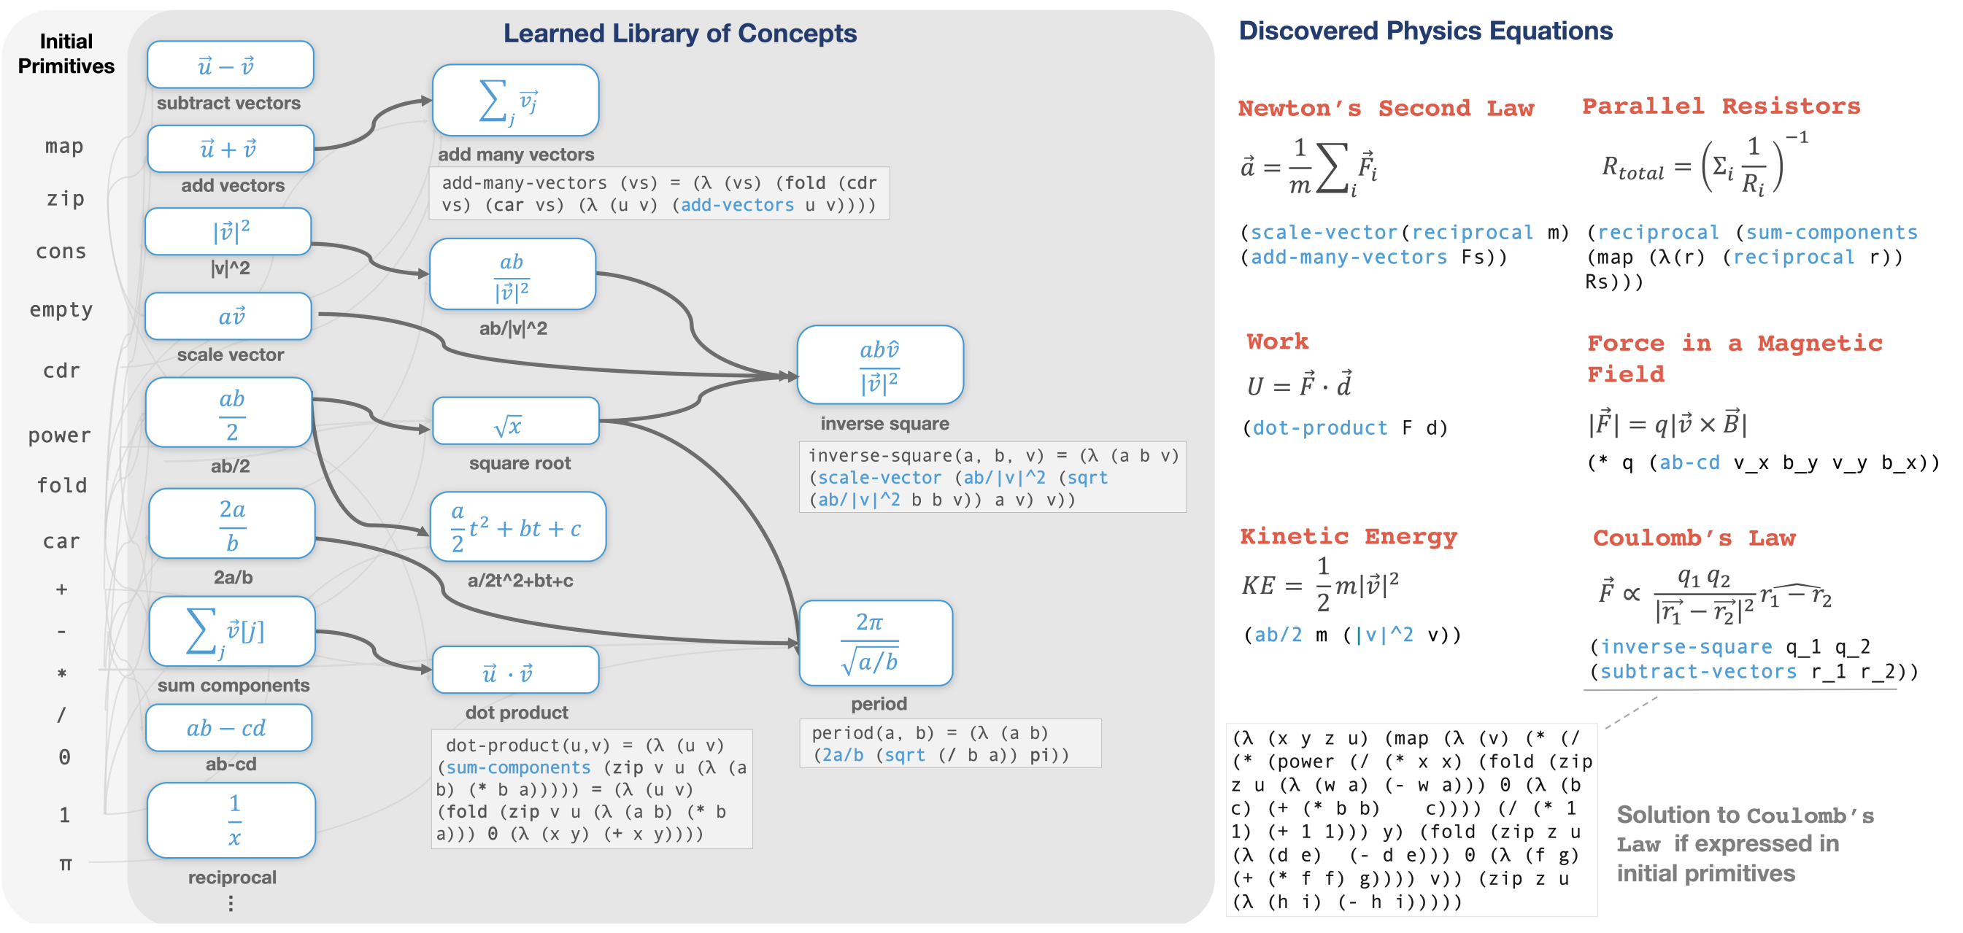
DreamCoder

Slide 17
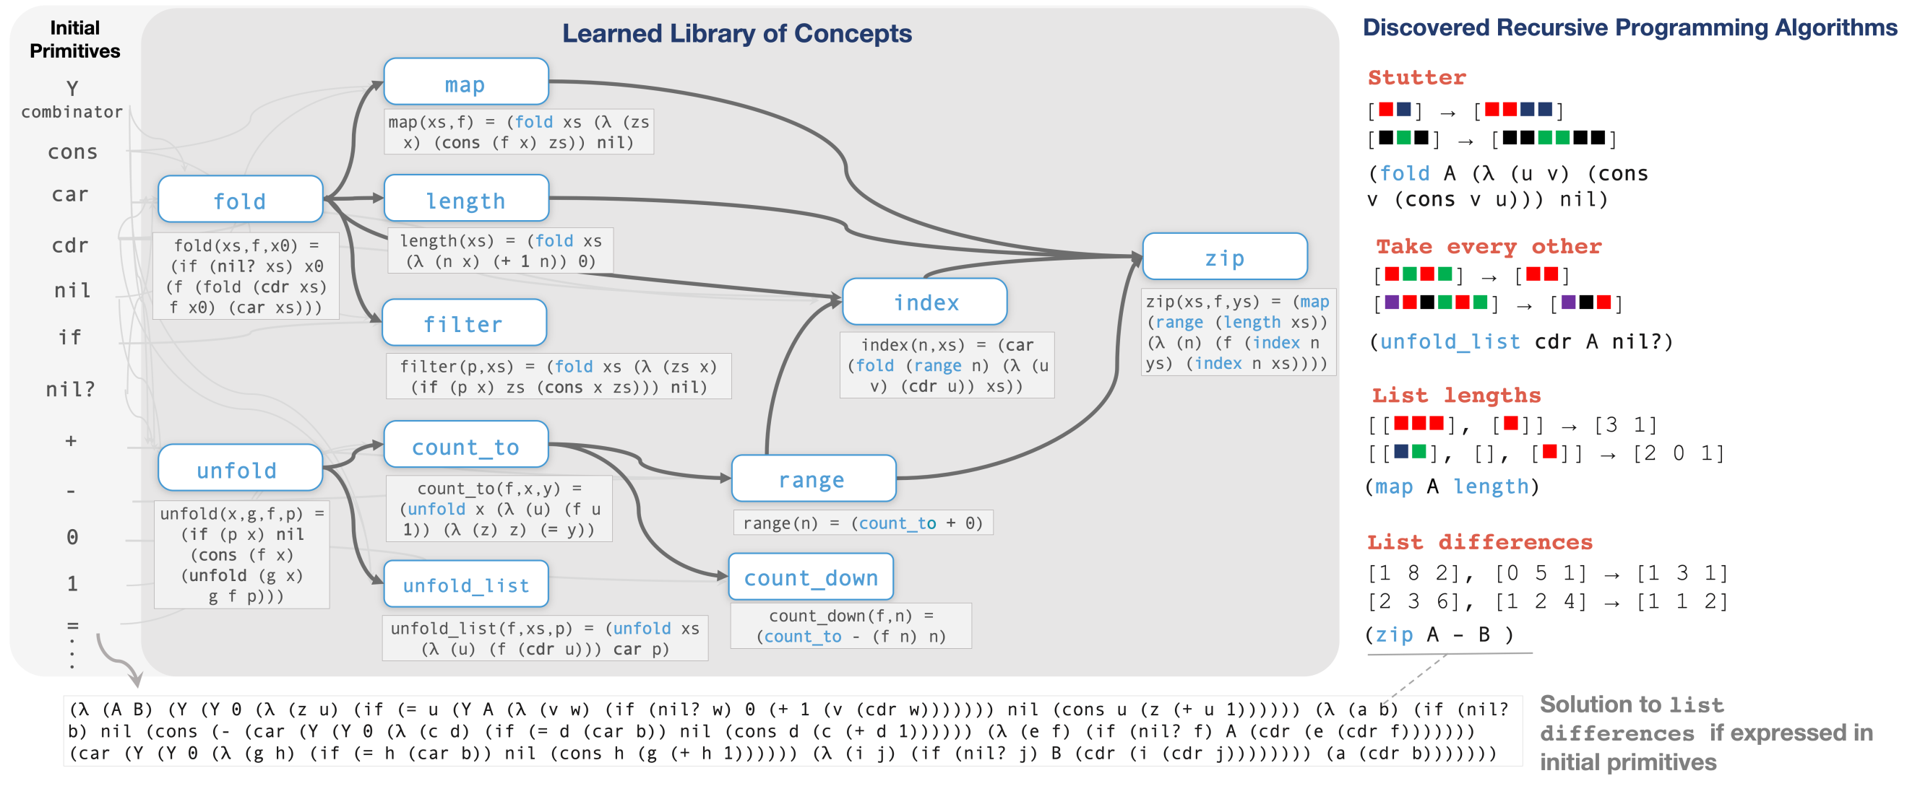
DreamCoder: Recursive algorithms
Can do recursion

Slide 18
DreamCoder: Results

Slide 19
DreamCoder
DreamCoder is a big step forward engineering-wise
Connection to pLoT/cognition not yet fully elaborated
Difficult to use
Mention stitch (Matt Bowers!)

Slide 20
The Child as Hacker

Slide 21
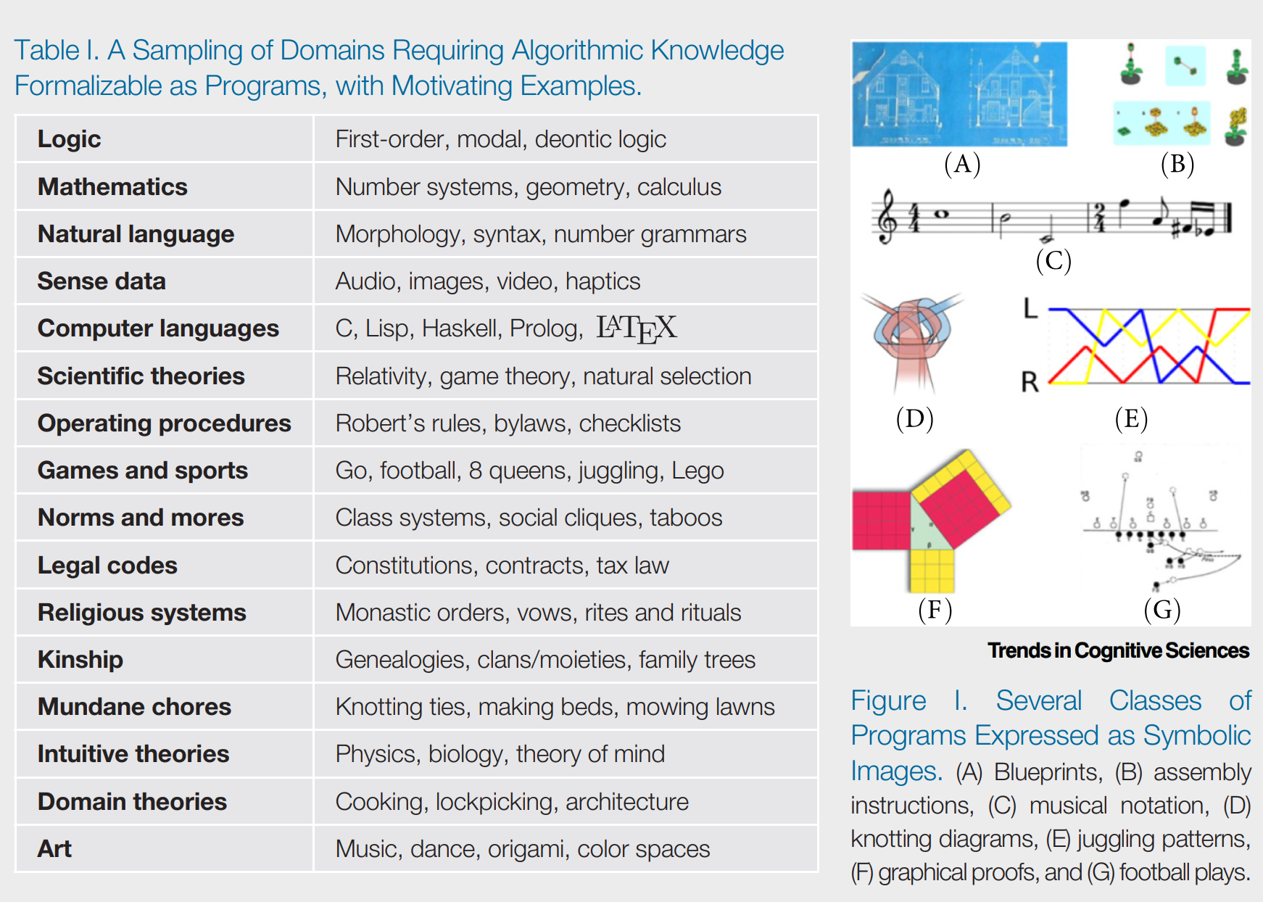
Starting point
pLoT is powerful but limited to:
stochastic search
for descriptions of data
with a simplicity preference
What else can we do with the pLoT?
pLoT production as computer programs
Look at strategies of human programmers!

Slide 22
The Child as Hacker
Rule et al. 2020, The Child as Hacker.
Programs = general-purpose representations for knowledge, inference, planning
Human learning = program induction
Hacking:
making code better
along many dimensions
through an open-ended and internally motivated set of goals and activities.

Slide 23
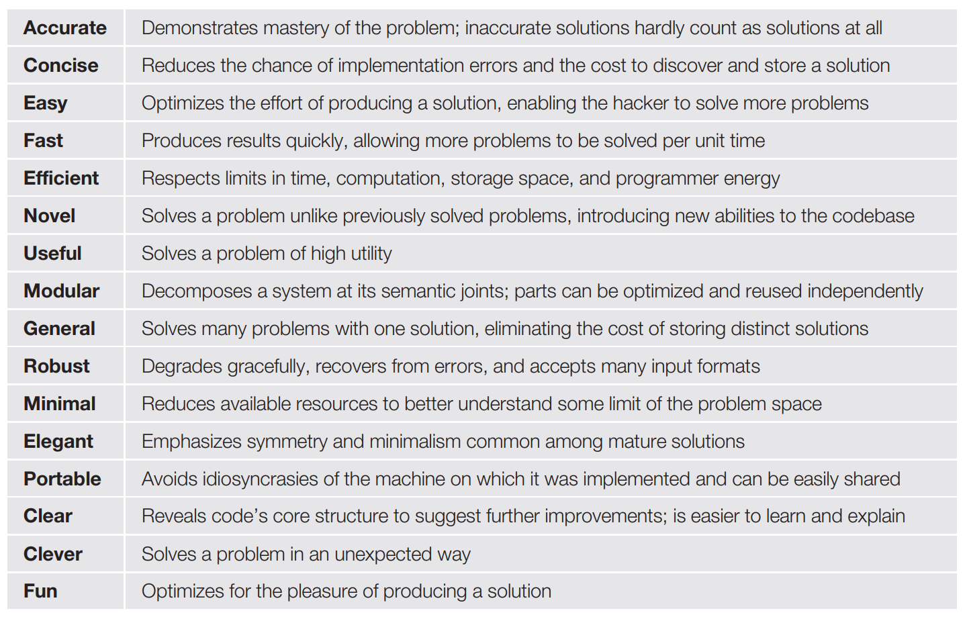
The Child as Hacker – New goals

Slide 24
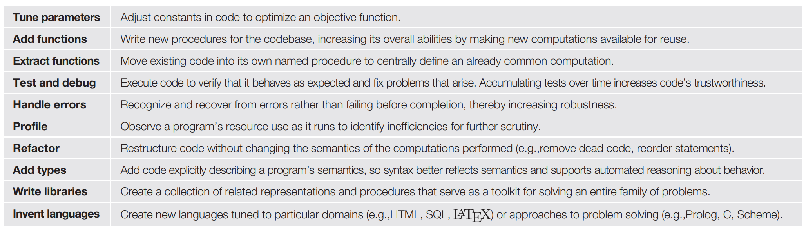
The Child as Hacker – New strategies

Slide 25
The Child as Hacker – New questions
How might traditional accounts of cognitive development be usefully reinterpreted through the lens of hacking? How can core knowledge be mapped to an initial codebase? How can domain-specific knowledge be modeled as code libraries? What chains of revisions develop these libraries? How do libraries interact with each other? Which hacking techniques are attested in children and when do they appear? Which values? How can individual learning episodes be interpreted as improving code?
What are children’s algorithmic abilities? How do they learn in the absence of new data? What aspects of learning are data-insensitive? How do they extract information from richly structured data? What kinds of nonlocal transformations do we see? Do children ever find more complex theories before finding simpler ones? How do children move around the immense space of computationally expressive hypotheses?

Slide 26
The Child as Hacker – New questions
How do humans program? What techniques do they use? What do they value in good code? How do they search the space of programs? Does the use of many techniques make search more effective?
How can the discoveries of computer science best inform models of human cognition? For example, what remains to be learned about human cognition from the study of compilers, type systems, or databases? How can we use the vocabulary of programming and programming languages to more precisely characterize the representational resources supporting human cognition? Are things like variable binding, symbolic pattern matching, or continuations cognitively primitive? If so, are they generally available or used only for specific domains? How does the mind integrate symbolic/discrete and statistical/continuous information during learning? What kinds of goals do children have in learning?

Slide 27
Conclusions

Slide 28
Sources of empirical evidence
Models based on pLoT can explain…
Experimental data
Error rates
Learning speed
Language acquisition data
Typological distribution
Attested category systems simpler under an LoT
What else?

Slide 29

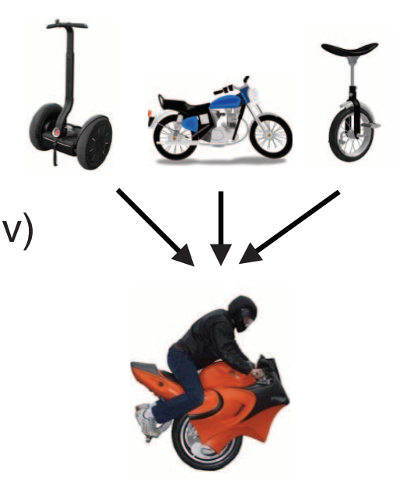
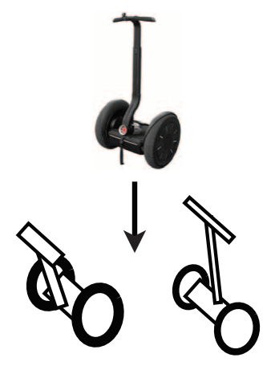
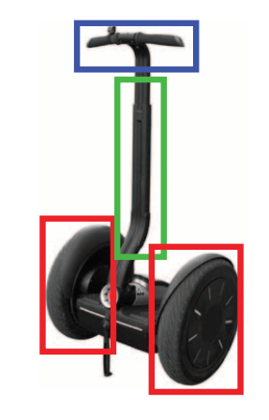
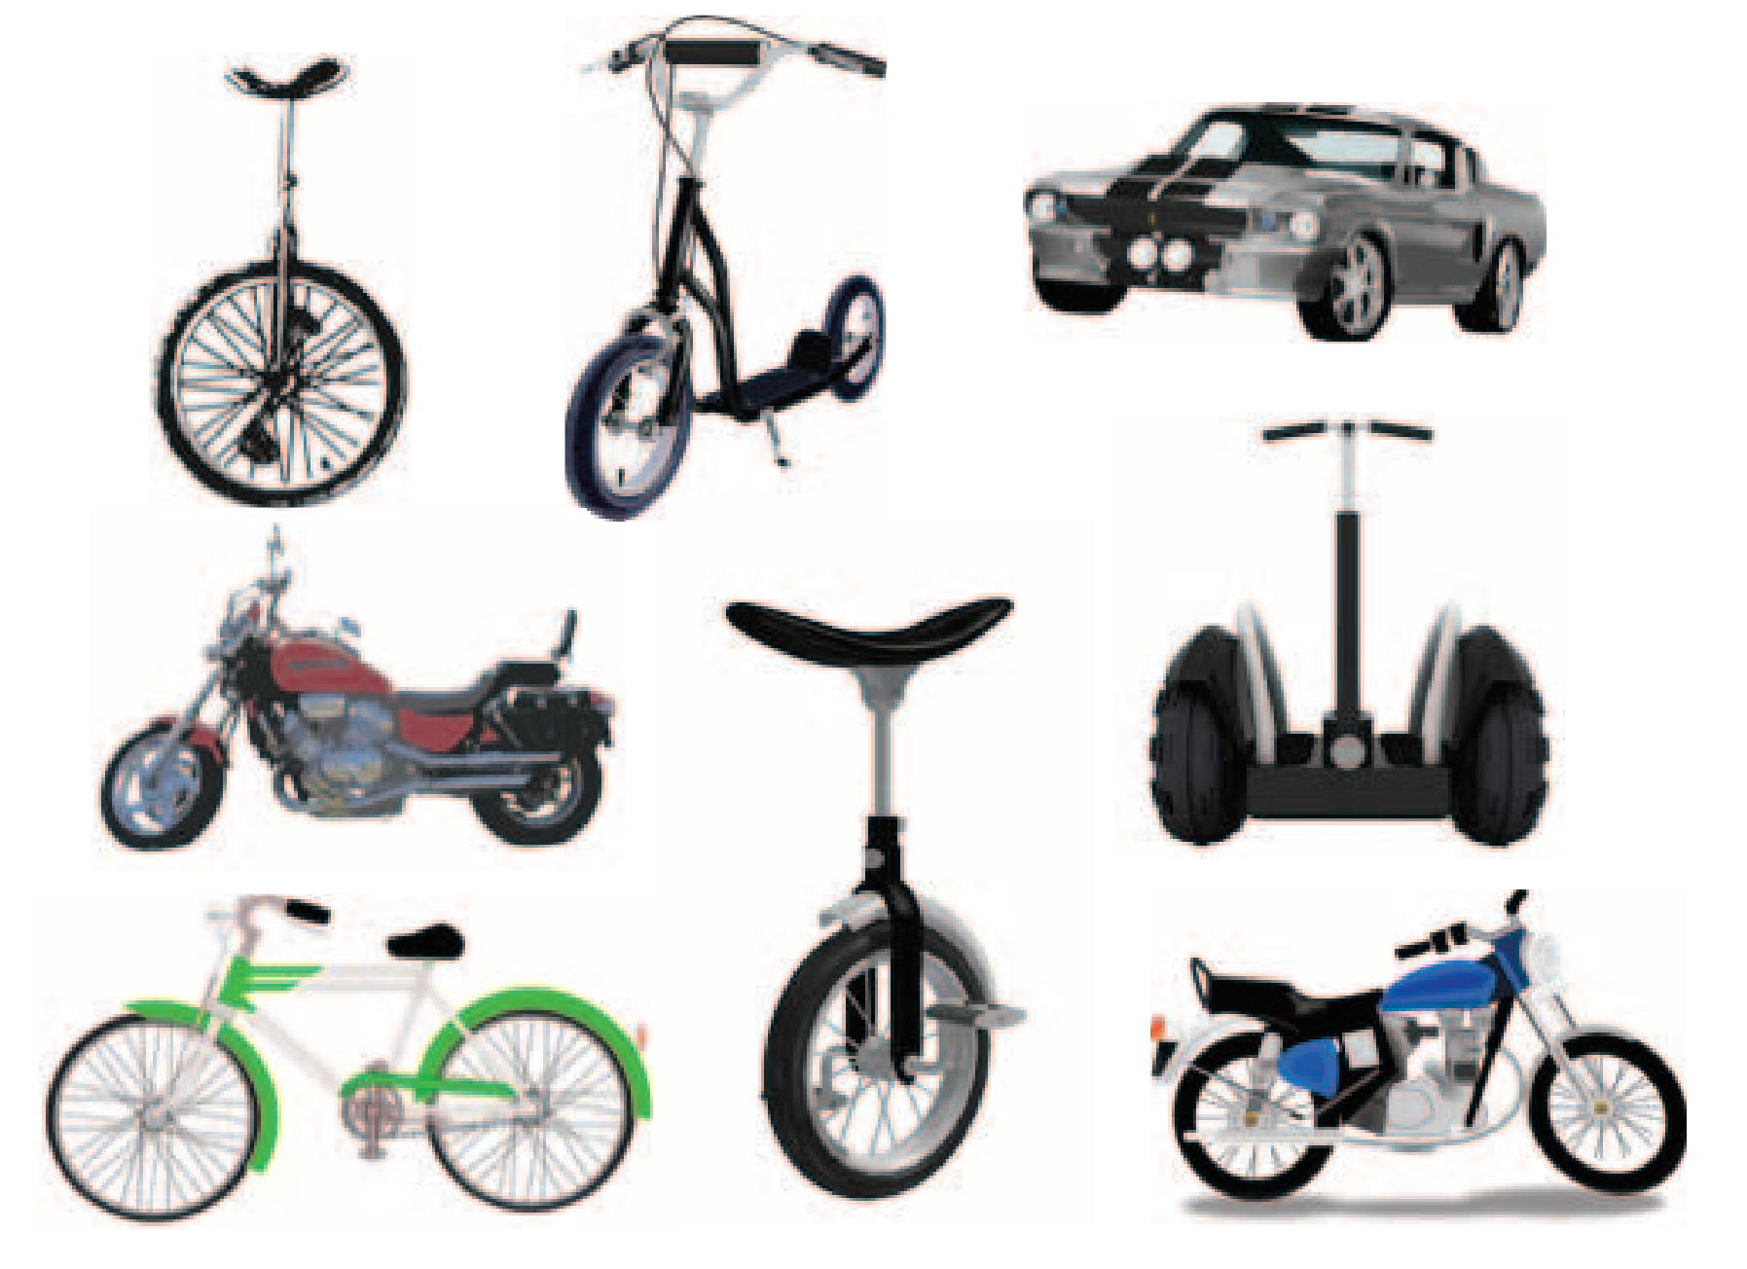
Learning a rule
Robert Feldman → Dr Feldman
Ruth Millican → Dr Millikan
Joanna Newsom → Dj Newsom
“Dr <last name>” or “D<first letter of first name> <last name>”?
6 @ 2 = 12
3 @ 4 = 12
10 @ 2 = 12
@ = multiplication or
return 12?
Lake et al (2015)
Classification
Example generation
Parsing
Concepts generation

Slide 30
Some closing considerations

Slide 31
Some closing considerations

